Slide 1
COMPUTATIONL MATHEMATICS
Name

Slide 2
Problem 1.
5 points
P(X>x | X>y) = 0.7875256
The probability of X greater than median value of X given that X is greater than first quartile of y is 0.78.
b. P(X>x, Y>y) = 0.3754
The probability of X greater than median value of X and Y is greater than first quartile of y is 0.3754.
c. P(X<x | X>y) = 0.2124744
The probability of X less than median value of X given that X is greater than first quartile of y is 0.2124744.

Slide 3
5 points. Investigate whether P(X>x and Y>y)=P(X>x)P(Y>y) by building a table and evaluating the marginal and joint probabilities
We’ve built the following marginal and joint probability table first
 | Y<y | Y=y | Y>y | Total
X<x | 1254 | 0 | 3746 | 5000
X=x | 0 | 0 | 0 | 0
X>x | 1246 | 0 | 3754 | 5000
Total | 2500 | 0 | 7500 | 10000
From the marginal and conditional probability table we can see that the condition holds since
P(X>x and Y>y) = 0.3754 and
P(X>x)P(Y>y) = 0.375 are approximately equal.

Slide 4
5 points. Check to see if independence holds by using Fisher’s Exact Test and the Chi Square Test. What is the difference between the two? Which is most appropriate?
We ran fisher’s exact test and chi square tests. From which we found that independence holds here.
Fisher's exact test the null of independence of rows and columns in a contingency table with fixed marginals.
Chi-squared test tests contingency table tests and goodness-of-fit tests.
Fisher's exact test is appropriate here. Since the contingency table are fixed here in the table.
The r code and output are on the next slides

Slide 5
Answer:
Fisher’s Exact Test
fisher.test(table(X>x,Y>y))
## ## Fisher's Exact Test for Count Data ## ## data: table(X > x, Y > y) ## p-value = 0.8716 ## alternative hypothesis: true odds ratio is not equal to 1 ## 95 percent confidence interval: ## 0.9202847 1.1052820 ## sample estimates: ## odds ratio ## 1.00857
The p-value is greater than zero we reject the null hypothesis. Two events are independent.
The Chi Square Test

Slide 6
The Chi Square Test
chisq.test(table(X>x,Y>y))
## ## Pearson's Chi-squared test with Yates' continuity correction ## ## data: table(X > x, Y > y) ## X-squared = 0.026133, df = 1, p-value = 0.8716
The p-value is greeter than zero we reject the null hypothesis. Two events are independent.
Fisher’s exact test the null of independence of rows and columns in a contingency table with fixed marginals.
Chi-squared test tests contingency table tests and goodness-of-fit tests.
Fisher’s exact test is appropriate here. Since the contingency table are fixed here in the table.

Slide 7
Problem 2
You are to register for Kaggle.com (free) and compete in the House Prices: Advanced Regression Techniques competition. https://www.kaggle.com/c/house-prices-advanced-regression-techniques . I want you to do the following.
Load the libraries

Slide 8
5 points. Descriptive and Inferential Statistics.
Provide univariate descriptive statistics and appropriate plots for the training data set.
Provide a scatter-plot matrix for at least two of the independent variables and the dependent variable.x
Derive a correlation matrix for any three quantitative variables in the data-set.
Discuss the meaning of your analysis. Would you be worried about family-wise error? Why or why not?

Slide 9
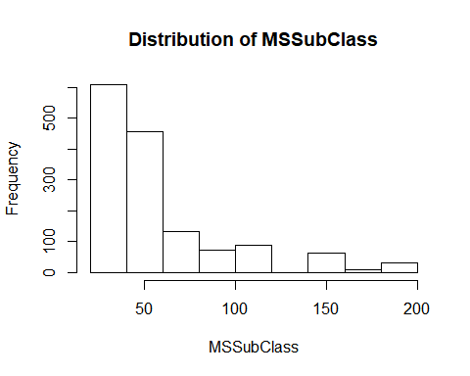
MSSubClass is left skewed.

Slide 10
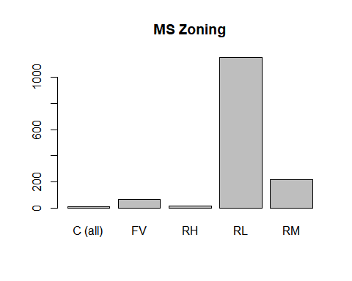
RL has the highest frequency , C(all) has the lowest frequency.
RL has the highest

Slide 11
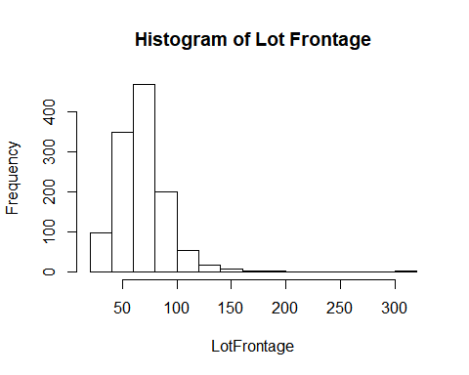
LotFrontage is left skewed

Slide 12
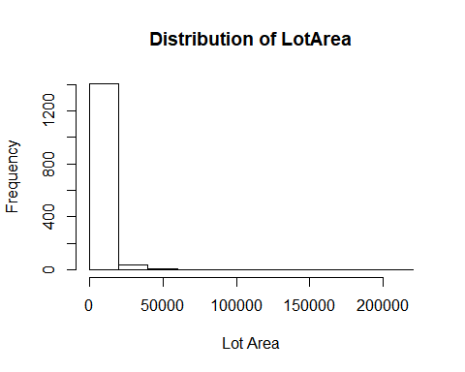
Lot Area is left skewed with very high small values.

Slide 13
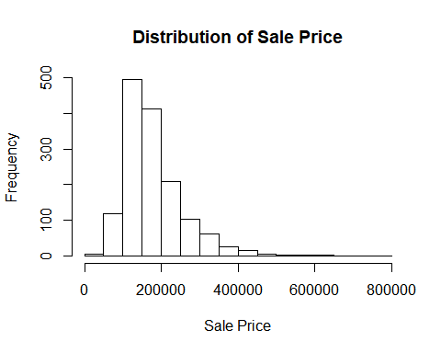
Sales price is slightly approximately normally distributed.

Slide 14
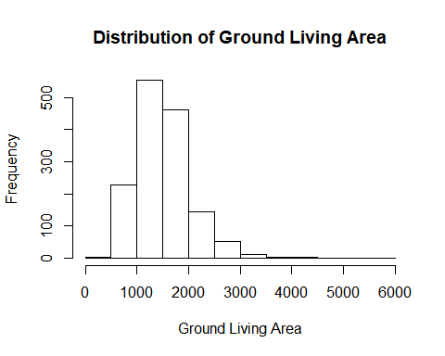
Ground Living Area is approximately normally distributed.

Slide 15
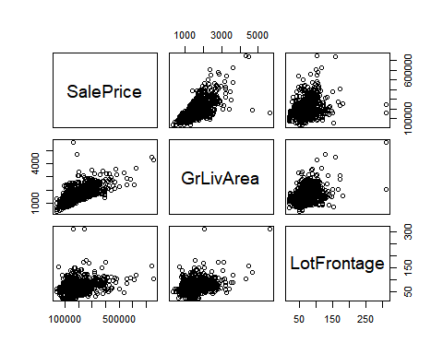
From the scatter plot we can see that GrLiveArea and LotFrontage are positively correlated with Sale Price.

Slide 16
Correlation matrix for any three quantitative variables
SalePrice , GrLivArea and TotalBsmtSF
## SalePrice GrLivArea TotalBsmtSF ## SalePrice 1.0000000 0.7086245 0.6135806 ## GrLivArea 0.7086245 1.0000000 0.4548682 ## TotalBsmtSF 0.6135806 0.4548682 1.0000000
SalePrice shows strong positive correlation with GrLivArea and moderate correlation with TotalBsmTSF.
GrLivArea shows Strong positive correlation with SalePrice and weak positive correlation with TotalBsmSF.
TotalBsmSF shows moderate positive correlation with SalePrice and weak positive correlation with GrLivArea.
Test the hypotheses that the correlations between each pairwise set of variables is 0 and provide an 80% confidence interval. SalePrice vs GrLivArea
Null Hypothesis: The correlation between GrLivArea and SalePrice is 0 Alternative Hypothesis: The correlation between GrLivArea and SalePrice is other than 0
p-value < 0.00000000000000022
Since the the p value of the test is less than 0.05 at 5% level of significance we reject the null hypothesis and conclude that the correlation between GrLivArea and SalePrice is other than 0. 80 percent confidence interval of the test is 0.6939620 0.7285864

Slide 17
Null Hypothesis: The correlation between TotalBsmtSF and SalePrice is 0 Alternative Hypothesis: The correlation between TotalBsmtSF and SalePrice is other than 0
p-value < 0.00000000000000022
Since the the p value of the test is less than 0.05 at 5% level of significance we reject the null hypothesis and conclude that the correlation between TotalBsmtSF and SalePrice is other than 0.
80 percent confidence interval of the test is 0.5792077 0.6239328

Slide 18
Null Hypothesis: The correlation between TotalBsmtSF and GrLivArea is 0 Alternative Hypothesis: The correlation between TotalBsmtSF and GrLivArea is other than 0
p-value < 0.00000000000000022
Since the the p value of the test is less than 0.05 at 5% level of significance we reject the null hypothesis and conclude that the correlation between GrLivArea and TotalBsmtSF is other than 0.
80 percent confidence interval of the test is 0.4327076 0.4879552

Slide 19
family wise error
#### family wise error
```{r}
FWE <- 1 - (1 - .05)^2
FWE
```
There are 3 tests and alpha = 0.05 . We than calculated family wise error.
There is a 9.75% chance of type 1 error. Since the chance is low I will not be worried for family wise error .

Slide 20
5 points. Linear Algebra and Correlation. Invert your correlation matrix from above. (This is known as the precision matrix and contains variance inflation factors on the diagonal.) Multiply the correlation matrix by the precision matrix, and then multiply the precision matrix by the correlation matrix. Conduct LU decomposition on the matrix.
# find inverse precision_mat <- solve(cormat) # Multiply the correlation matrix by the precision matrix cor_prec <- cormat %*% precision_mat cor_prec
## SalePrice GrLivArea ## SalePrice 1.00000000000000022204460 -0.00000000000000002081668 ## GrLivArea 0.00000000000000005551115 1.00000000000000000000000 ## TotalBsmtSF 0.00000000000000000000000 0.00000000000000005551115

Slide 21
## TotalBsmtSF ## SalePrice 0.0000000000000000000000 ## GrLivArea 0.0000000000000001110223 ## TotalBsmtSF 1.0000000000000000000000
# multiply the precision matrix by the correlation matrix prec_cor <- precision_mat %*% cormat prec_cor
## SalePrice GrLivArea ## SalePrice 0.9999999999999997779554 -0.0000000000000001665335 ## GrLivArea 0.0000000000000002012279 1.0000000000000004440892 ## TotalBsmtSF 0.0000000000000000000000 0.0000000000000001110223 ## TotalBsmtSF ## SalePrice -0.0000000000000001110223 ## GrLivArea 0.0000000000000001665335 ## TotalBsmtSF 1.0000000000000000000000
# LU Decomposistion library(pracma) ## Attaching package: 'pracma'
## The following object is masked from 'package:purrr': lu(cormat)
## $L ## SalePrice GrLivArea TotalBsmtSF ## SalePrice 1.0000000 0.00000000 0 ## GrLivArea 0.7086245 1.00000000 0 ## TotalBsmtSF 0.6135806 0.04031325 1 ## ## $U ## SalePrice GrLivArea TotalBsmtSF ## SalePrice 1 0.7086245 0.6135806 ## GrLivArea 0 0.4978513 0.0200700 ## TotalBsmtSF 0 0.0000000 0.6227098

Slide 22
5 points. Calculus-Based Probability & Statistics. Many times, it makes sense to fit a closed form distribution to data. Select a variable in the Kaggle.com training dataset that is skewed to the right, shift it so that the minimum value is absolutely above zero if necessary. Then load the MASS package and run fitdistr to fit an exponential probability density function. (See https://stat.ethz.ch/R-manual/R-devel/library/MASS/html/fitdistr.html ).

Slide 23
optimal value of exponential for this distribution
library(MASS)
## ## Attaching package: 'MASS'

Slide 24
## The following object is masked from 'package:dplyr': ## ## select
# Fitting of univariate distribution (fd <- fitdistr(train$LotArea, "exponential"))
## rate ## 0.000095085704 ## (0.000002488507)
# optimam value of lambda fd$estimate
## rate ## 0.0000950857
1000 samples from this exponential distribution using this value
values <- rexp(1000, rate = fd$estimate) par(mfrow=c(1,2)) # Actual vs simulated distribution hist(train$LotArea, breaks=40, prob=TRUE, xlab="Lot Area", main="Lot Area Distribution") hist(values, breaks=40, prob=TRUE, xlab="Generated Data", main="Generated Data's Distribution")

Slide 25
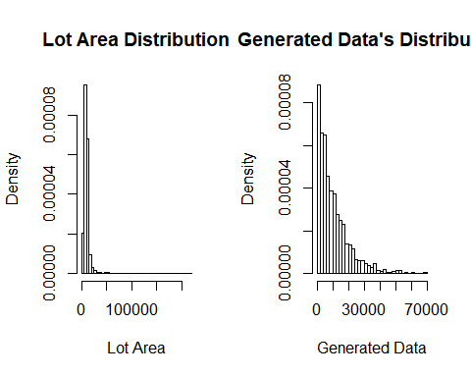
From the two plots we can see that our Lot Area approximately fits a exponential distribution. The fit isn’t very well here.

Slide 26
10 points. Modeling. Build some type of multiple regression model and submit your model to the competition board. Provide your complete model summary and results with analysis. Report your Kaggle.com user name and score.
Model Building Steps:
Prepare the data.
Fit multiple logistic regression model
Do Stepwise regression
Find the best fitted model
Do residual Analysis
Predict the output of test data using final model.
Submit the submission.csv file to Kaggle.com for scoring.

Slide 27
Model Summary:
For building model I’ve removed the variables with very large number of missing values. Then recoded the categorical variables to numerical variable. After that I’ve fitted a multiple regression model. After fitting the multiple regression model I’ve used step wise regression to select best set of predictor variables.
Final Model:
Based on our final model model’s R squared value is 0.8373. It’s a good fitted model. The assumptions of multiple linear regression are satisfied here.

Slide 28

Our Final model
Our Final model
$$SalePrice_{i}=−68655.8503−159.8789237∗MSSubClass_{i}−2503.0986100∗MSZoning_{i}+0.3814427∗LotArea_{i}+40806.0476399∗Street_{i}−1310.5265783∗LotShape_{i}+3914.9209353∗LandContour_{i}+6115.5393877∗LandSlope_{i}−7336.6649714∗Condition2_{i}−1224.6139620∗HouseStyle_{i}+12959.5730624∗OverallQual_{i}+4247.8548222∗OverallCond_{i}+2632.4405086∗RoofStyle_{i}+4131.9524015∗RoofMatl_{i}−614.3119175∗Exterior1st_{i}+4335.1775745∗MasVnrType_{i}+30.2912∗MasVnrArea_{i}−8542.1790∗ExterQual_{i}−8542.1790∗Foundation_{i}+BsmtQual_{i}+3202.5638∗BsmtCond_{i}−3678.7800∗BsmtExposure_{i}−1168.7326∗BsmtFinType1_{i}+5.8341∗BsmtFinSF1_{i}+45.5519∗1stFlrSF_{i}+7523.9163∗2ndFlrSF_{i}+BsmtFullBath_{i}+4197.5166∗FullBath_{i}−4439.2566∗BedroomAbvGr_{i}+3456.5692∗KitchenAbvGr_{i}−8746.4950∗KitchenQual_{i}+3456.5692∗TotRmsAbvGrd_{i}+3843.4812∗Functional_{i}+4035.7108∗Fireplaces_{i}+14425.7154∗GarageCars_{i}+4949.3592∗PavedDrive_{i}+18.4401∗WoodDeckSF_{i}+41.4813∗ScreenPorch_{i}+2596.0989∗SaleCondition_{i}$$
R squared values 0.8373 indicates that our model is a very good model. Our fitted multiple regression model is 83.73% accurate in predicting Sales price based on the dependent variables. Since the F tests p value less than 0.05 at 5% level of significance our model is a valid model.

Slide 29
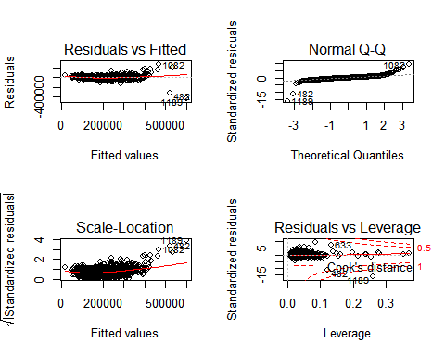
From the residuals plot we can see that the assumptions of multiple regression model are satisfied. The residuals are approximately normally distributed. There is not heteroscedacity and pattern in the residuals. Do prediction

Slide 30
Kaggle Submission
Kaggle username is kaggle_username. Final score is kaggle user name.

Slide 31
Thank You

